Slide 1

Zomato
Data Visualization & Analysis
By- Bhavesh Khanchandani
© All rights reserved by Fireblaze Technologies Pvt. Ltd.

Slide 2
Problem Statement
To find possible insights from given Zomato dataset using data visualization.
© All rights reserved by Fireblaze Technologies Pvt. Ltd.

Slide 3
Proposed Solution
To find possible insights from given Zomato dataset using data visualization By using python libraries like Seaborn and Matplotlib
© All rights reserved by Fireblaze Technologies Pvt. Ltd.

Slide 4
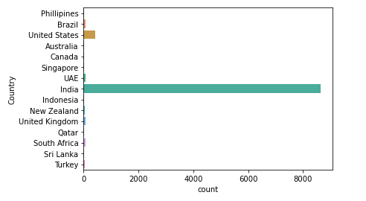
Descriptive Analysis
Country with the highest number of Restaurants
We can see India tops the list
Zomato is an Indian company
© All rights reserved by Fireblaze Technologies Pvt. Ltd.

Slide 5
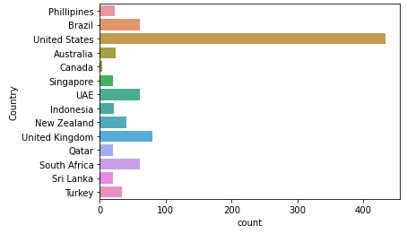
Descriptive Analysis
Country after India with the highest number of Restaurants
We can see that United States is on the top
© All rights reserved by Fireblaze Technologies Pvt. Ltd.

Slide 6
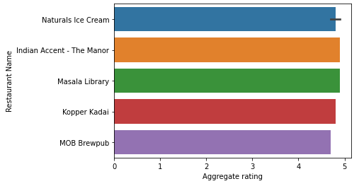
Descriptive Analysis
India’s top 5 best Restaurants in Delhi by rating
© All rights reserved by Fireblaze Technologies Pvt. Ltd.

Slide 7
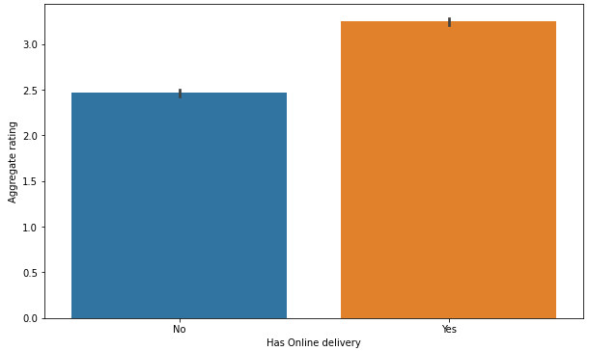
Descriptive Analysis
Ratings of the Restaurants with vs without online delivery
© All rights reserved by Fireblaze Technologies Pvt. Ltd.

Slide 8
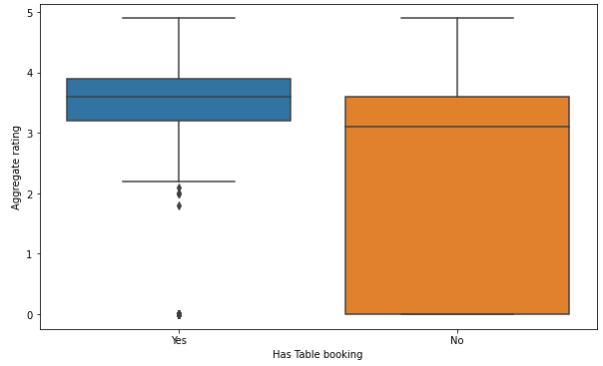
Descriptive Analysis
Ratings of the Restaurants which have Table booking
© All rights reserved by Fireblaze Technologies Pvt. Ltd.

Slide 9
Advantages
Can analyze specific data of Restaurants
Can compare cities and countries based on qifferent paramenters
Can analyze most preferred dish/cuisines across country
Can provide list of top restaurants based on their ratings and votes
© All rights reserved by Fireblaze Technologies Pvt. Ltd.

Slide 10
Diadvantages
More than 80% data is for country India, so that we can't get much insight on other countries
Some outliers are present in the average price for two column
© All rights reserved by Fireblaze Technologies Pvt. Ltd.

Slide 11
Conclusion
By Visualizing the data we get to know about some useful insights like:
From the given group of countries India has most restaurants, so company should focus on expanding its business in India.
Even though India has lots of restaurants, very few restaurants have feature of online delivery.
Among the cities in India New Delhi has highest number of restaurants.
© All rights reserved by Fireblaze Technologies Pvt. Ltd.

Slide 12
Future Scope
Large number of Restaurants is not using online delivery yet, company need to focus on collaborating with these restaurants in order to expand business.
New Delhi has highest number of restaurants, company must try to collaborate with these restaurants and it should also appoint big group of delivery boys in order to handle all the deliveries in New Delhi area.
Local cuisines like North Indian are preferred by large group of individuals. So company should provide some discount on these dishes in order to attract large group of individuals.
© All rights reserved by Fireblaze Technologies Pvt. Ltd.

